Slide 1


Parallel and Distributed Systems / 6
Pavel Krömer, Dept. of Computer Science, VSB – Technical University of Ostrava

Slide 2
Agenda
Programming distributed memory systems
MPI and friends
Literature
Peter Pacheco, An Introduction to Parallel Programming, Elsevier, 2011 (Ch. 3)
Alexander Supalov, Inside the message passing interface, DeGruyter

Slide 3
Distributed memory systems
Notes:
what do we associate with digital transformation/DSM?
Is that all new? Is this change the first?

Slide 4
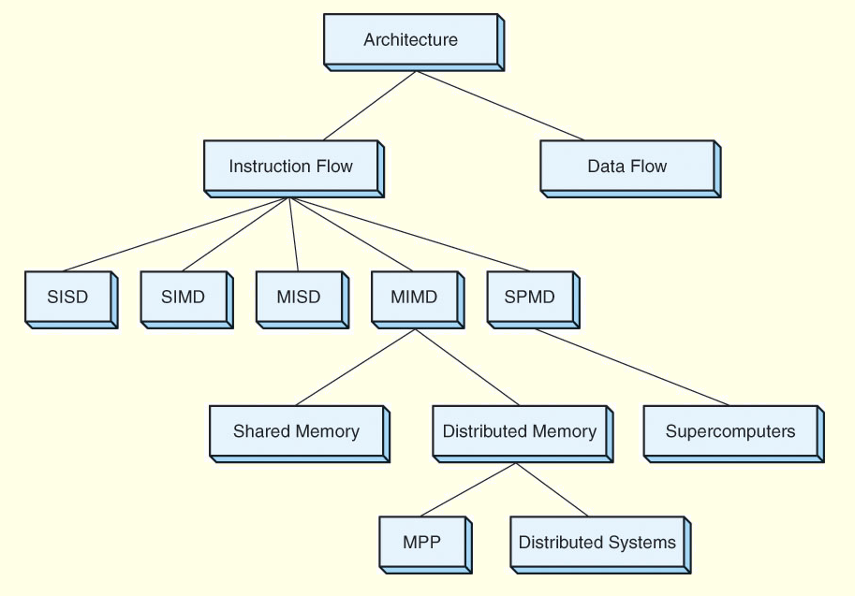

Slide 5
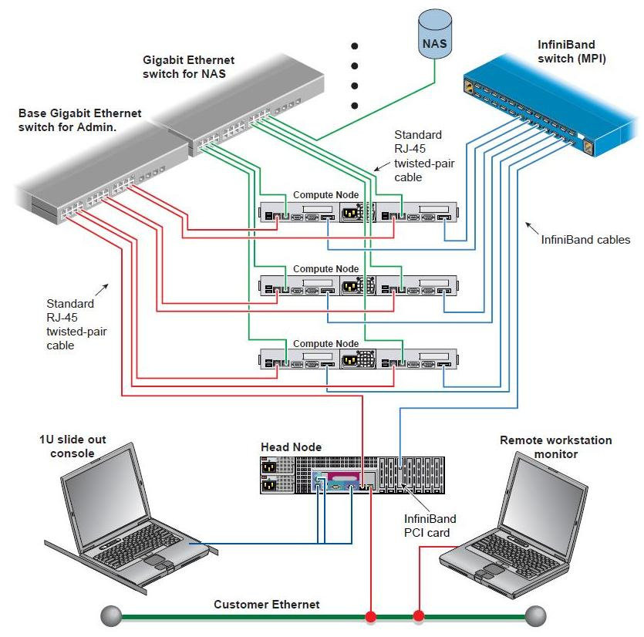
Programming Distributed Memory systems
Need for a different model than shared memory systems
loosely coupled systems
no (physical) shared memory
communication/coordination by hand or using a framework/tool

Slide 6



Message Passing Interface
A unified approach to the design and implementation of distributed applications
an industry standard, stewarded by the MPI Forum (over 40 organizations)
similar roles (different tools) as OpenMP for shared memory programming
A standard of distributed applications (not only) for HPC
apps very often (but not exclusively) following the SPMD model
syntax and semantics of a standard set of library functions covering common communication scenarios
Interface and implementation de-coupled
Open-source vs. Commercial MPIs
Bindings) for C/C++, Fortran 77/95
M(VA)PICH(2), LAM/MPI, OpenMPI

Slide 7
MPI: Main features
Standardization
the only message passing library that can be considered a standard. It is supported on virtually all HPC platforms, has replaced all previous message passing libraries.
Portability
Little or no need to modify your source code when you port your application to a different platform that supports (and is compliant with) the MPI standard.
Performance Opportunities
Vendor implementations can exploit native hardware features to optimize performance. Any implementation is free to develop optimized algorithms.
Functionality
over 430 routines defined in MPI-3 (superset of MPI-2 and MPI-1). Most MPI programs can be written using a dozen or less routines.

Slide 8
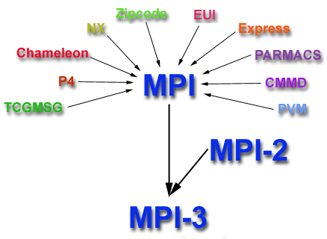
MPI: Historical perspective
Apr 1992: Workshop on Standards for Message Passing in a Distributed Memory Environment, sponsored by the Center for Research on Parallel Computing, Williamsburg, Virginia.
Nov 1992: Working group meets in Minneapolis. MPI draft proposal (MPI1), formation of the MPI Forum
Nov 1993: draft MPI standard presented at Supercomputing’93
May 1994: Final version of MPI-1.0 released (1.1: 1995; 1.2: 1997; 1.3: 2008)
1998: MPI-2 (2.1: 2008; 2.2: 2009)
Sep 2012: The MPI-3.0 (3.1: 2015)

Slide 9
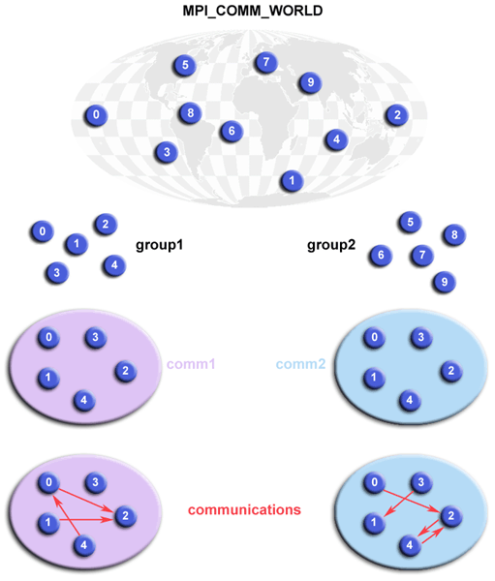
MPI: An application and its world
collection of processes that exchange data in the form of messages
(usually) a general-purpose SPMD application that can scale well
coordination of IO operations
the communicator and group concepts to define the hierarchy of communicating processes

Slide 10
The MPI Ecosystem
Rank
an ID of a process within a communicator (numerical, starting 0)
source and destination ‘address’ of messages
Size
no. of processes within a communicator

Slide 11
MPI operations and communication
blocking operations
when they return, all resources are ready for another use
all state changes are finished
non-blocking operations
may return before all operations are finished
call of a non-blocking operation initiates the operation
synchronous comm.
sending is finished when receiving process gets the message
asynchronous comm.
no synchronization of sending and receiving

Slide 12
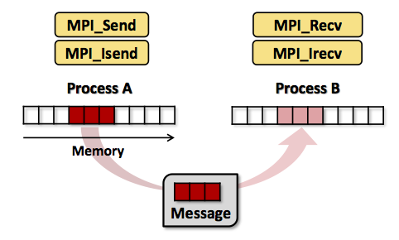
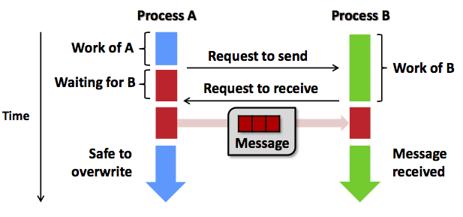
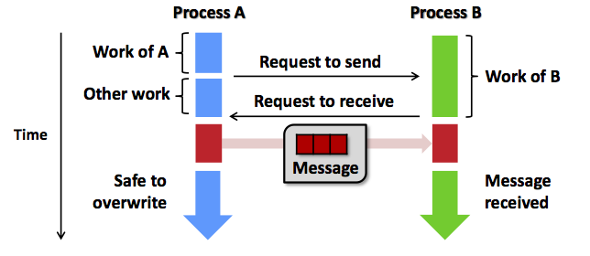
Point-2-point communication
Information exchange between 2 MPI ranks
Workflow
Initialization
MPI_Init, MPI_Comm_rank,
MPI_Comms ize
Message transmission
MPI_Send, MPI_Receive,
MPI_Sendrcv - blocking
Finalization and clean-up
vs. non-blocking, sync.
vs. async.

Slide 13
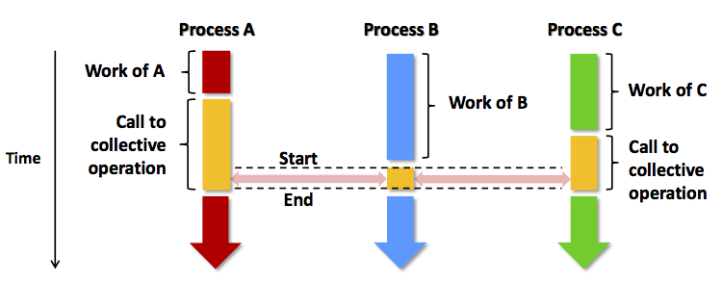
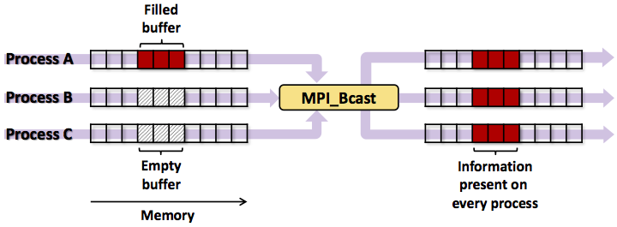
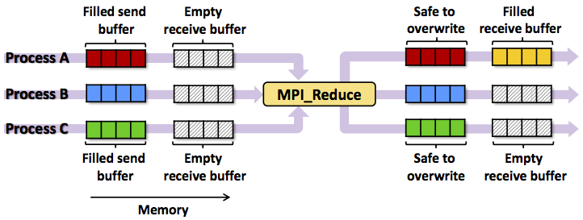
Collective and global communication
Information exchange between all ranks in a communicator
broadcasts (MPI_Bcast())
reductions (MPI_Reduce) - operations: max, min, sum, logic, bit ops.,
user defined reductions
gather (MPI_Gather)
scatter (MPI_Scatter)

Slide 14
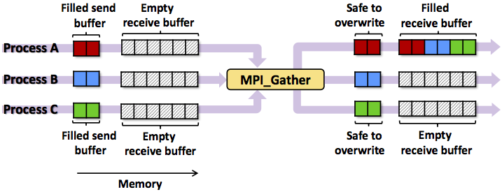
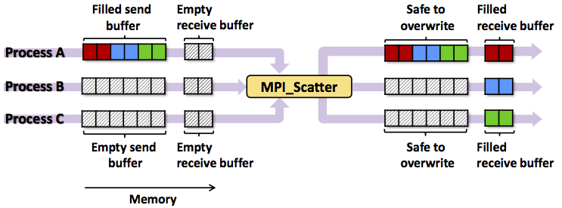
Collective and global communication
Information exchange between all ranks in a communicator
broadcasts (MPI_Bcast())
reductions (MPI_Reduce) - operations: max, min, sum, logic, bit ops.,
user defined reductions
gather (MPI_Gather)
scatter (MPI_Scatter)

Slide 15
MPI Caveats
order of messages (not guaranteed)
deadlocks
implementation and runtime agnostic programs

Slide 16
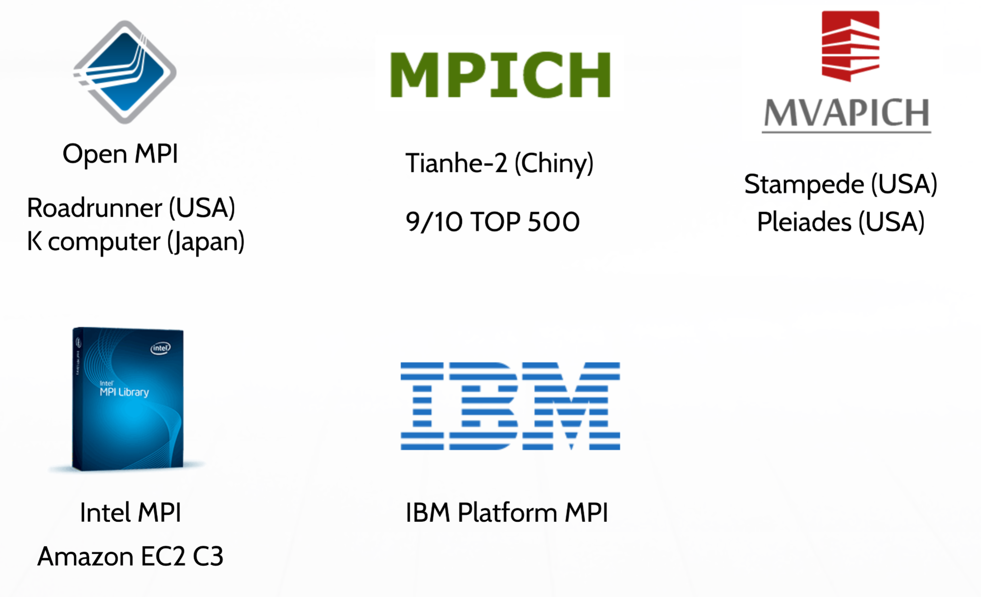
MPI Implementations

Slide 17
Partitioned Global Address Space
Notes:
what do we associate with digital transformation/DSM?
Is that all new? Is this change the first?

Slide 18

Partitioned global address space
Motivation
MPI provides an industry standard for programming of distributed systems
its bare-bones nature makes the app development for MPI harder than dev. for shared memory systems (longer code = more space for errors)
there are efforts to bring shared memory programming concepts to distributed memory programming
data and computation locality must be considered

Slide 19
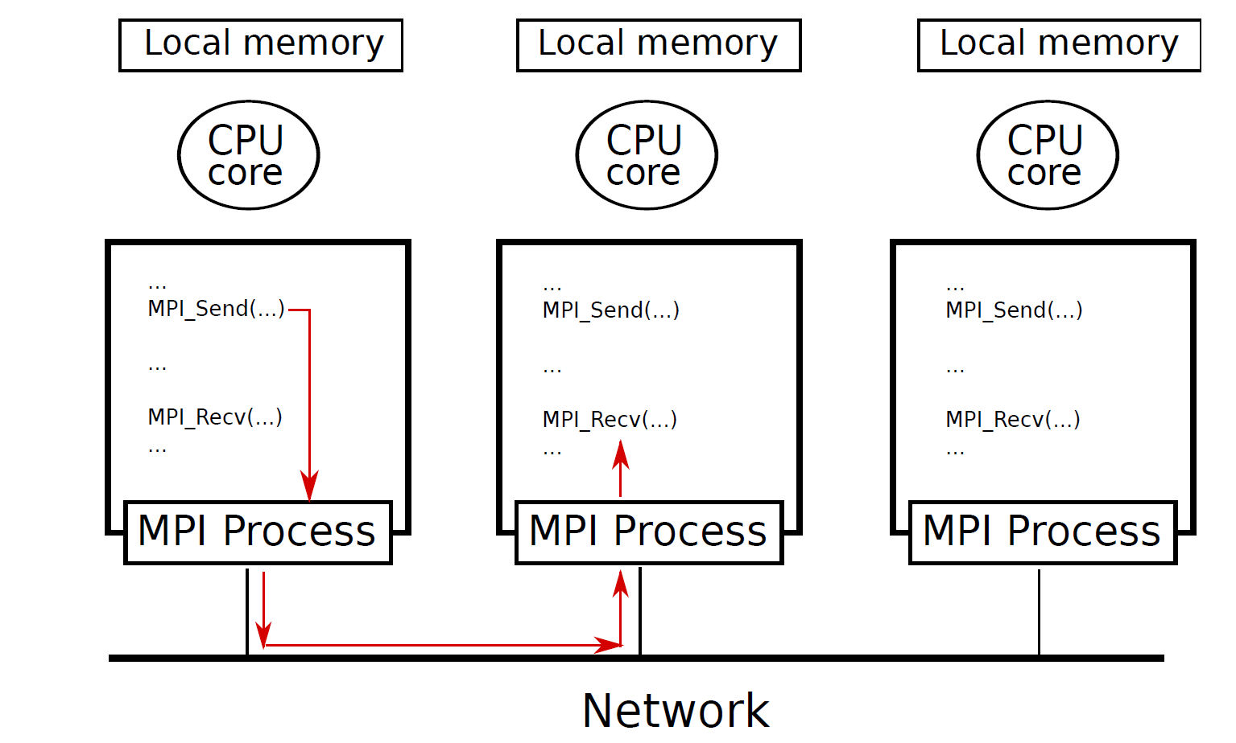
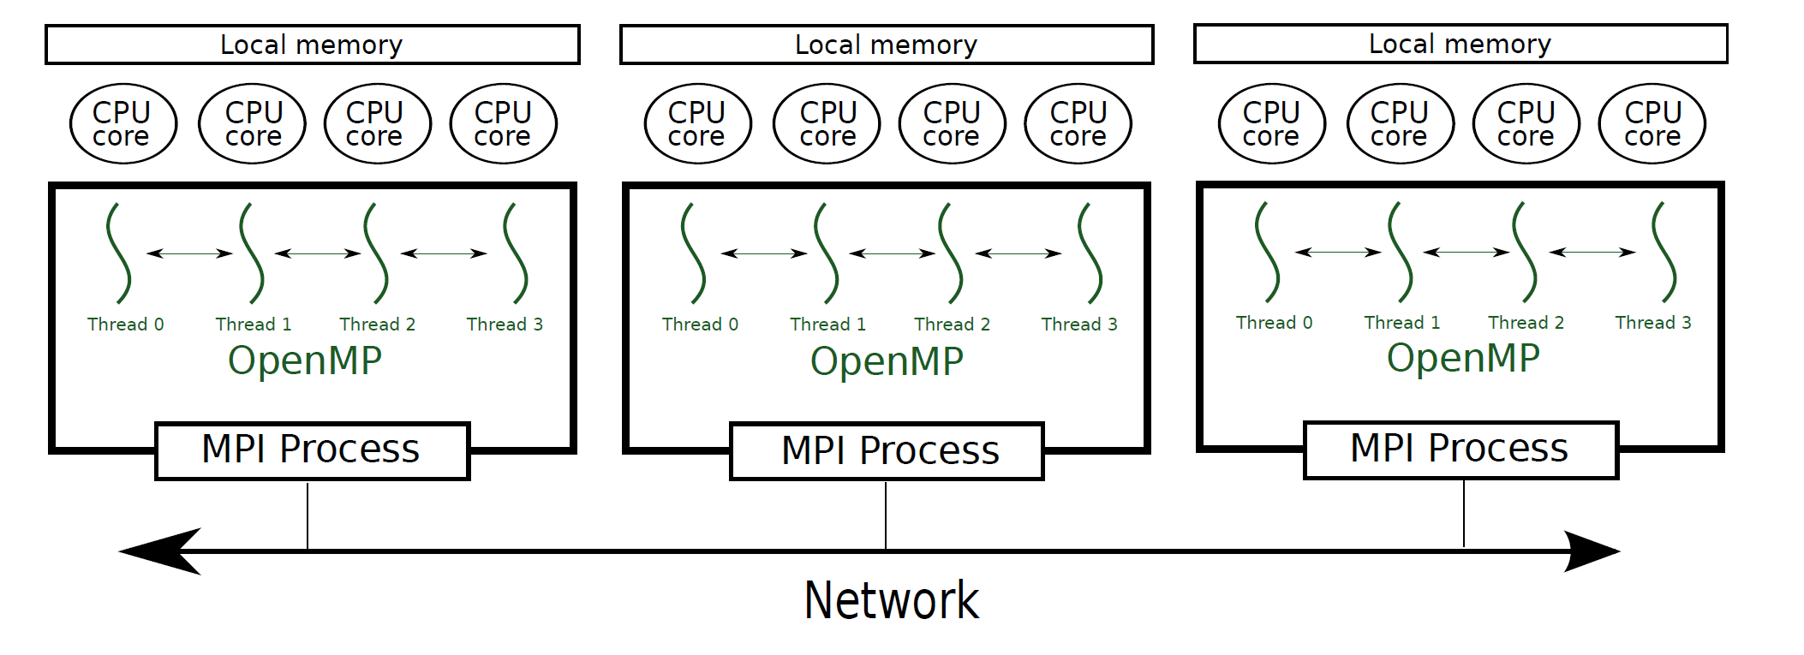
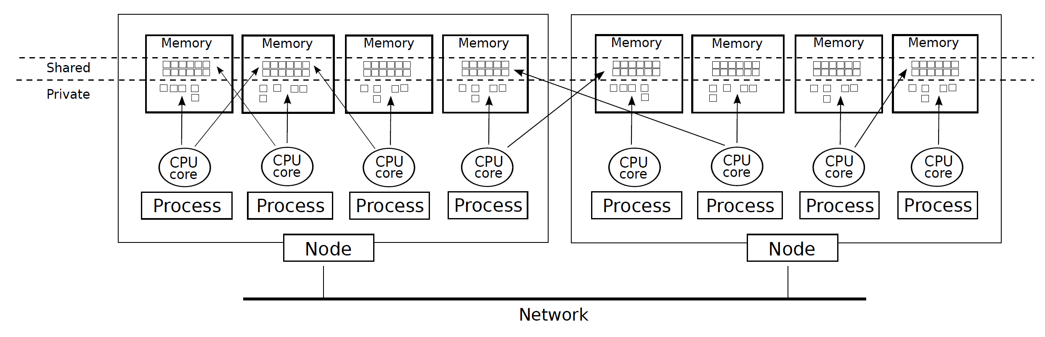
Partitioned global address space
Partitioned global address space (PGAS)
an abstract parallel programming model implemented by several languages
built around the concept of (virtual) distributed shared memory
MPI
MPI+OpenMP
PGAS

Slide 20
Partitioned global address space

Slide 21
PGAS application
Structure
each application is composed of multiple threads, each of them knows its identity
barriers, loop work sharing, parallel control libraries
Memory
private and shared memory
each thread has its own private memory
each thread can access any data in the shared memory; this, however, might be much more expensive
shared and private pointers

Slide 22
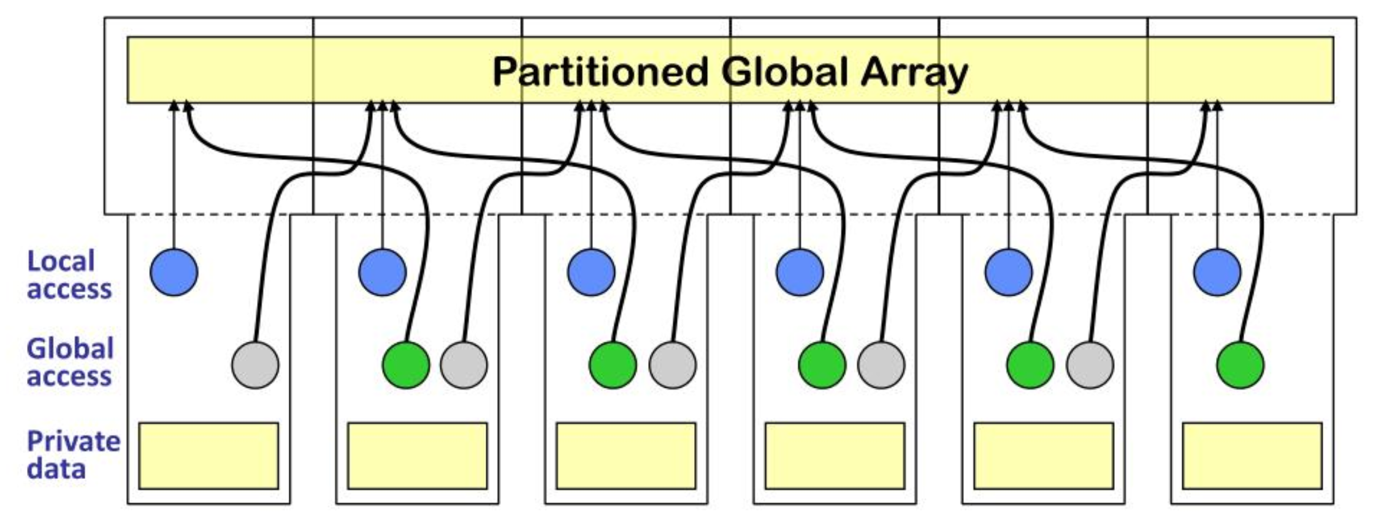
PGAS properties
Global address space memory model
Each thread can write memory anywhere in the system (convenience of shared memory)
Information about the locality of data
Some data is (guaranteed) local, some is global, potentially further away (locality and scalability of message passing)

Slide 23
PGAS design goals
Application
convenient distributed programming of irregular codes
graphs, Hash tables, Sparse matrices, Adaptive (hierarchical) meshes
Hardware
expose the best available performance on a given machine
low latency for small messages
high bandwidth even for medium sized messages
high injection bandwidth

Slide 24
PGAS communication backbone(s)
PGAS languages are built on top of several low-level communication libraries
Primitives that implement Remote Memory Access (for PGAS)
MPI, OpenSH-MEM, ARMCI, GASNet
GASNet
language independent, low-level networking
network-independent high-performance communication primitives
support of HPC networking hardware and standards (IVB verbs, Cray Gemini interconnects)
support for portable networking (mpi, udp conduits)

Slide 25
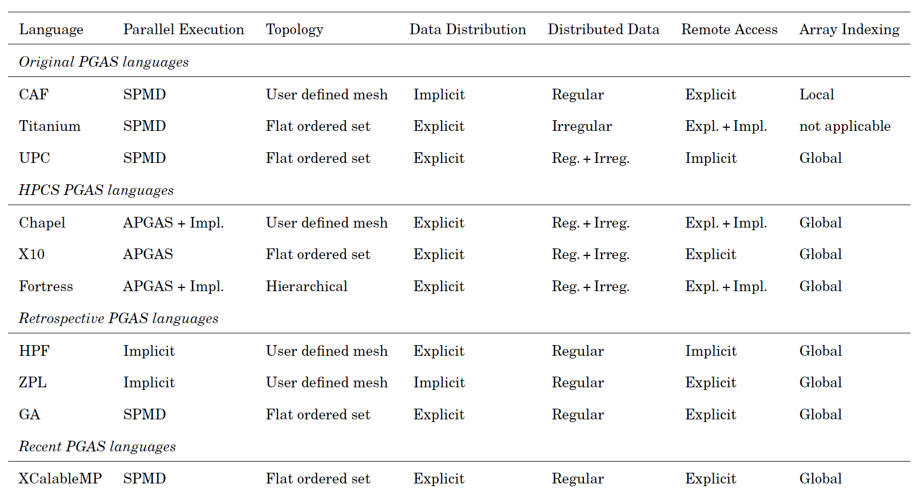
PGAS languages
Coarray Fortran
UPC
UPC++

Slide 26
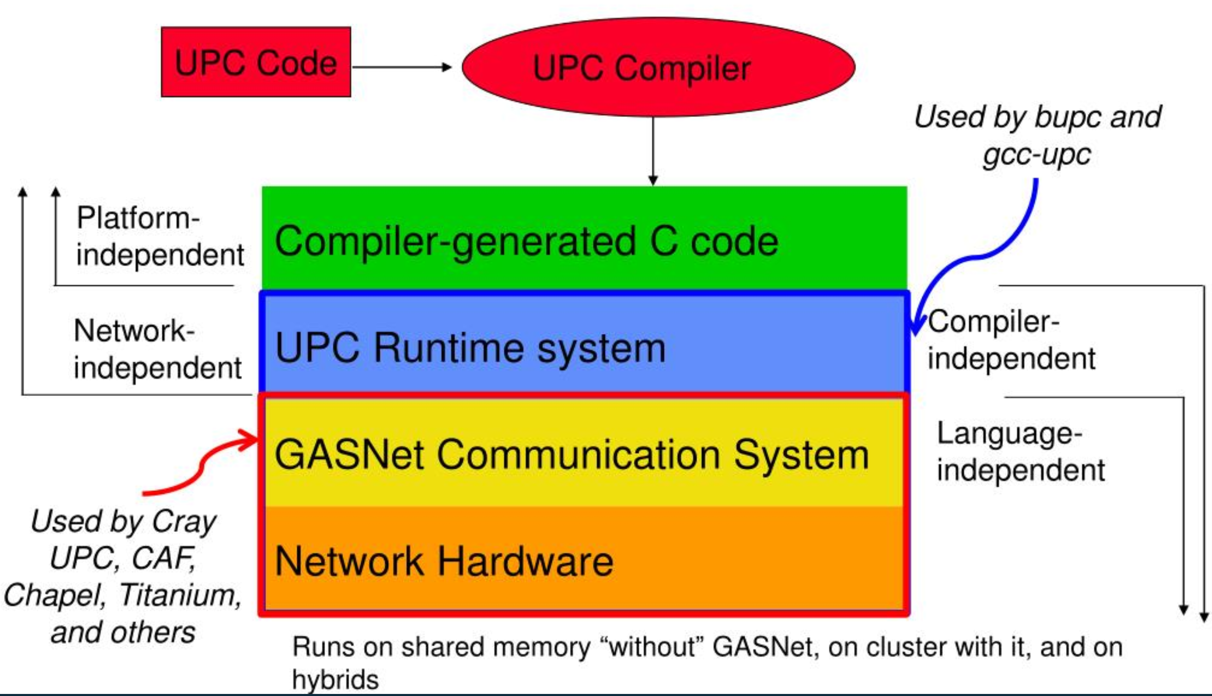
An example based on UPC
a minimalistic parallel extension to ANSI C implementing PGAS
shared arrays sliced by blocks (default block size = 1)

Slide 27
An example based on UPC
a minimalistic parallel extension to ANSI C implementing PGAS
shared arrays sliced by blocks (default block size = 1)
Example
shared int x;
shared int y[THREADS];
int z;
Example
shared int A[4][THREADS];

Slide 28
An example based on UPC
Example
#include <upc_relaxed.h>
#define N 100* THREADS
shared int v1[N], v2[N], v1v2[N];
void main()
{
int i;
for(i=THREAD; i < N; i+=THREADS)
v1v2[i] = v1[i] + v2[i];
}

Slide 29
An example based on UPC
Example
#include <upc_relaxed.h>
#define N 100* THREADS
shared int a [THREADS] [THREADS];
shared int b [THREADS], c [THREADS];
void main()
{
int i, j;
upc_forall(i=0; i < N; i++; i)
{
c[i] = 0;
for (j = 0; j< THREADS; j++)
c[i] += a[i][j] * b[j];
}
}

Slide 30
An example based on UPC
Example
#include <upc_relaxed.h>
#define N 100* THREADS
shared [THREADS] int a [THREADS] [THREADS];
shared int b [THREADS], c [THREADS];
void main()
{
int i, j;
upc_forall(i=0; i < N; i++; i)
{
c[i] = 0;
for (j = 0; j< THREADS; j++)
c[i] += a[i][j] * b[j];
}
}

Slide 31
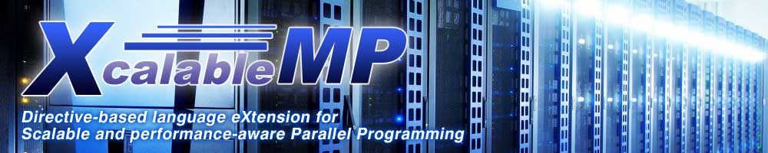

Recent development in PGAS
UPC++
a template-based approach, “compiler-free” PGAS
XCalableMP
a directive-based approach; omni-compiler
Parallel Computing in Java
Java style PGAS

Slide 32
Bulk Synchronous Parallel
Notes:
what do we associate with digital transformation/DSM?
Is that all new? Is this change the first?

Slide 33
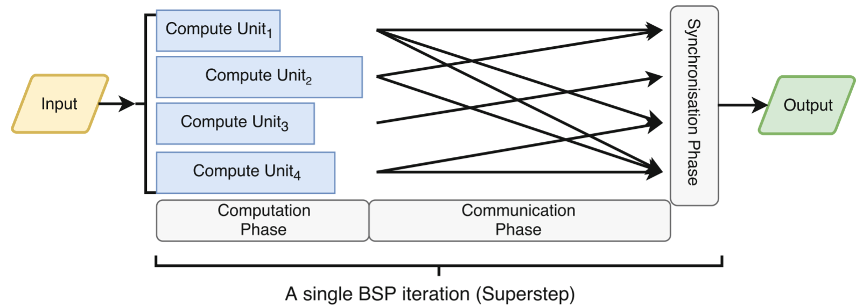
Bulk Synchronous Parallel
Three stages of parallel computation, repeated until completion:
Computation
Communication
Synchronization
An iterative share-nothing parallel computing model
Messages (possibly) transported between compute units, data sent at iteration i available at iteration i+1
Executes Business logic in concurrent tasks, applied to subsets of data

Slide 34
Bulk Synchronous Parallel
BSP advantages
simplifies parallel computation
automated balancing and scaling
suitable for heterogeneous environments
BSP disadvantages
restrictive model (code must be autonomous and independent)
explicit synchronization hard to achieve
slow computing units slow the whole computation
Sounds familiar?
MAPREDUCE
But also Pregel, SPARK etc.

Slide 35
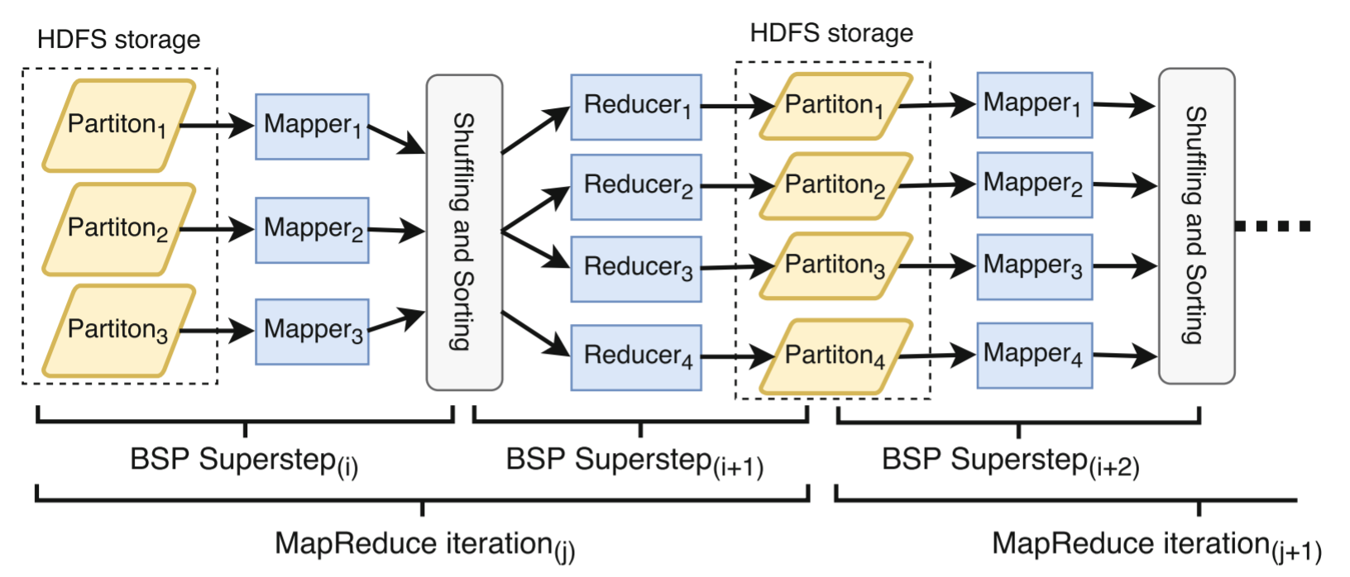
MapReduce
A general-purpose distributed system with automatic scalability and fault tolerance
Achieved through 2 user-defined operators, mappers and reducers
Notes:
- enables processing of massive amounts of unstructured data in parallel across a set of distributed computers
- developed by Google for Web indexing, popularized by free projects such as Apache Hadoop
- not used by Google anymore

Slide 36
Structure of a MapReduce job
processing of data divided into two phases, mapping and reducing
map function processes a key/value pair to generate a set of intermediate key/value pairs
reduce function merges all intermediate values associated with the same intermediate key
embraces distribution of data and parallel processing as well as aggregation of similar patterns
Config
Notes:
- enables processing of massive amounts of unstructured data in parallel across a set of distributed computers
- developed by Google for Web indexing, popularized by free projects such as Apache Hadoop
- not used by Google anymore

Slide 37
An Apache Hadoop -based example
Example
public void map(Object key, Text value, Context context )
throws IOException, InterruptedException {
StringTokenizer itr = new
StringTokenizer(value.toString());
while (itr.hasMoreTokens()) {
word.set(itr.nextToken());
context.write(word, one);
}
}
...
job.setCombinerClass(IntSumReducer.class);
...
public void reduce(Text key, Iterable<IntWritable> values, Context context)
throws IOException, InterruptedException {
int sum = 0;
for (IntWritable val : values) {
sum += val.get();
}
result.set(sum);
context.write(key, result);
}
Hadoop filesystem
a write-only filesystem-like application with data distributed across multiple nodes
supports replication, is fault-tolerant, and highly scalable
can deal with outages and is optimized for throughput
implemented using data nodes (store data), namenode (control of metadata) , and secondary namenode (not a backup but bookkeeping)
MapReduce layer
An API for writing MapReduce workflows in Java
A set of services for managing the execution of these workflows
Notes:
- enables processing of massive amounts of unstructured data in parallel across a set of distributed computers
- developed by Google for Web indexing, popularized by free projects such as Apache Hadoop
- not used by Google anymore

Slide 38
Python: DASK
Notes:
what do we associate with digital transformation/DSM?
Is that all new? Is this change the first?
PySpark, RAY
PySpark, and Pygion

Slide 39
Python: disturbed distribution
The strengths
de-facto language of data science
fast and optimized (native code, accelerators)
an existing ecosystem
The headaches
limited to single thread
limited to in-memory data
an existing ecosystem

Slide 40
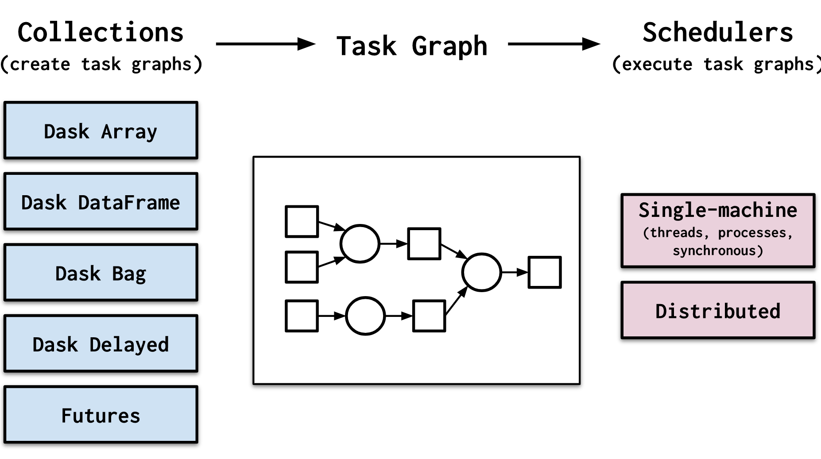
DASK
DASK is a flexible parallel computing paradigm for Python
Scales up and down well, resilient, responsive, realtime
Two essential parts
Dynamic task scheduling – optimization of computation
Big Data Collections – parallel containers

Slide 41
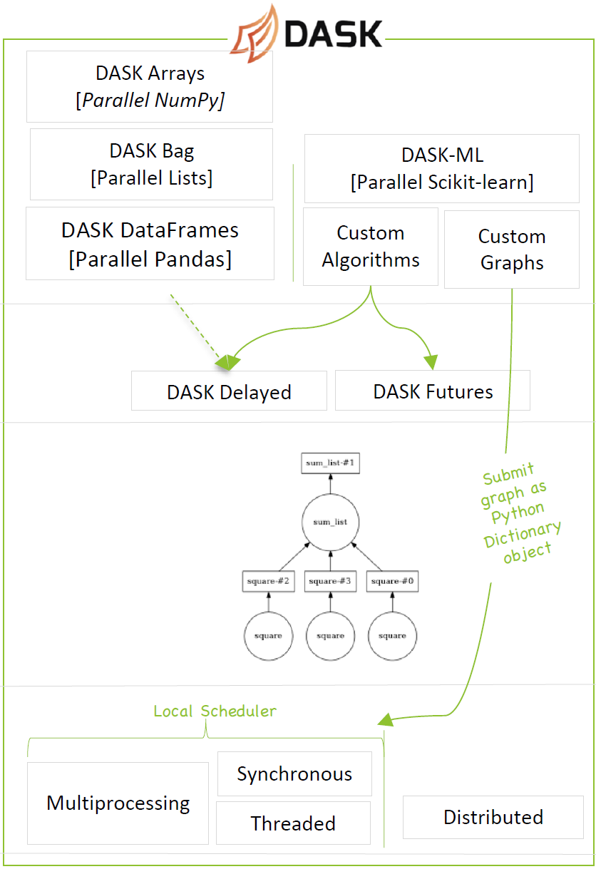
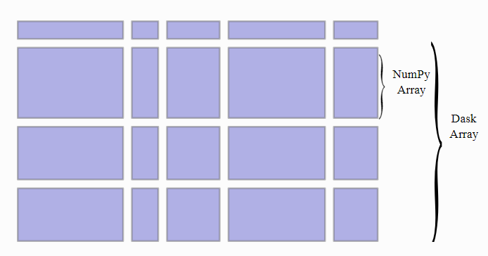
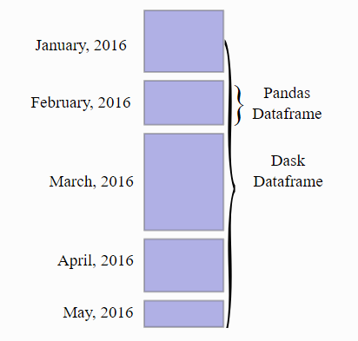
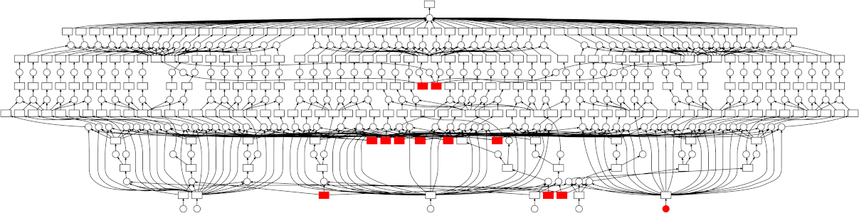
High-level API
Low(er)-level API
Task scheduling
Notes:
https://towardsdatascience.com/speeding-up-your-algorithms-part-4-dask-7c6ed79994ef

Slide 42
Dask.distributed
Centrally managed, distributed, dynamic task scheduler
Works on moderate-sized clusters
Low latency, complex scheduling, data locality
Warning: a relatively new project …

